Slide 1
Book Boost: Access for All Challenge, Guidelines for Creating Accessible Ebooks (Part 2): Image Descriptions
Sue-Ann Ma, Benetech Labs
December 12, 2017

Slide 2

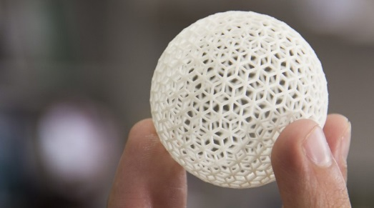

Benetech’s Global Literacy Program
Bookshare: Making reading accessible
Bookshare is the world’s largest library of accessible ebooks and lets people with visual, physical, and learning disabilities like dyslexia read in ways that work for them.
DIAGRAM Center: Building new paths to accessibility
DIAGRAM is a research and development center that creates tools, standards and best practices to support different learning needs.
Born Accessible: Creating accessible books from the start
Born Accessible is a partnership with publishers and content creators to help them build accessibility into books when they are first created.

Slide 3
Bookshare
580,000+ ebooks
850 publishing partners
550,000+ members worldwide
82 countries
12 million+ ebooks downloaded
34 languages
https://www.bookshare.org/
Notes:
Bookshare:
With federal education funding, providing books to students at $20 a student per year and dropping
Helping shape what accessible book delivery should look like here in the US and the in the rest of the world (e.g. Kenya or Canada)

Slide 4
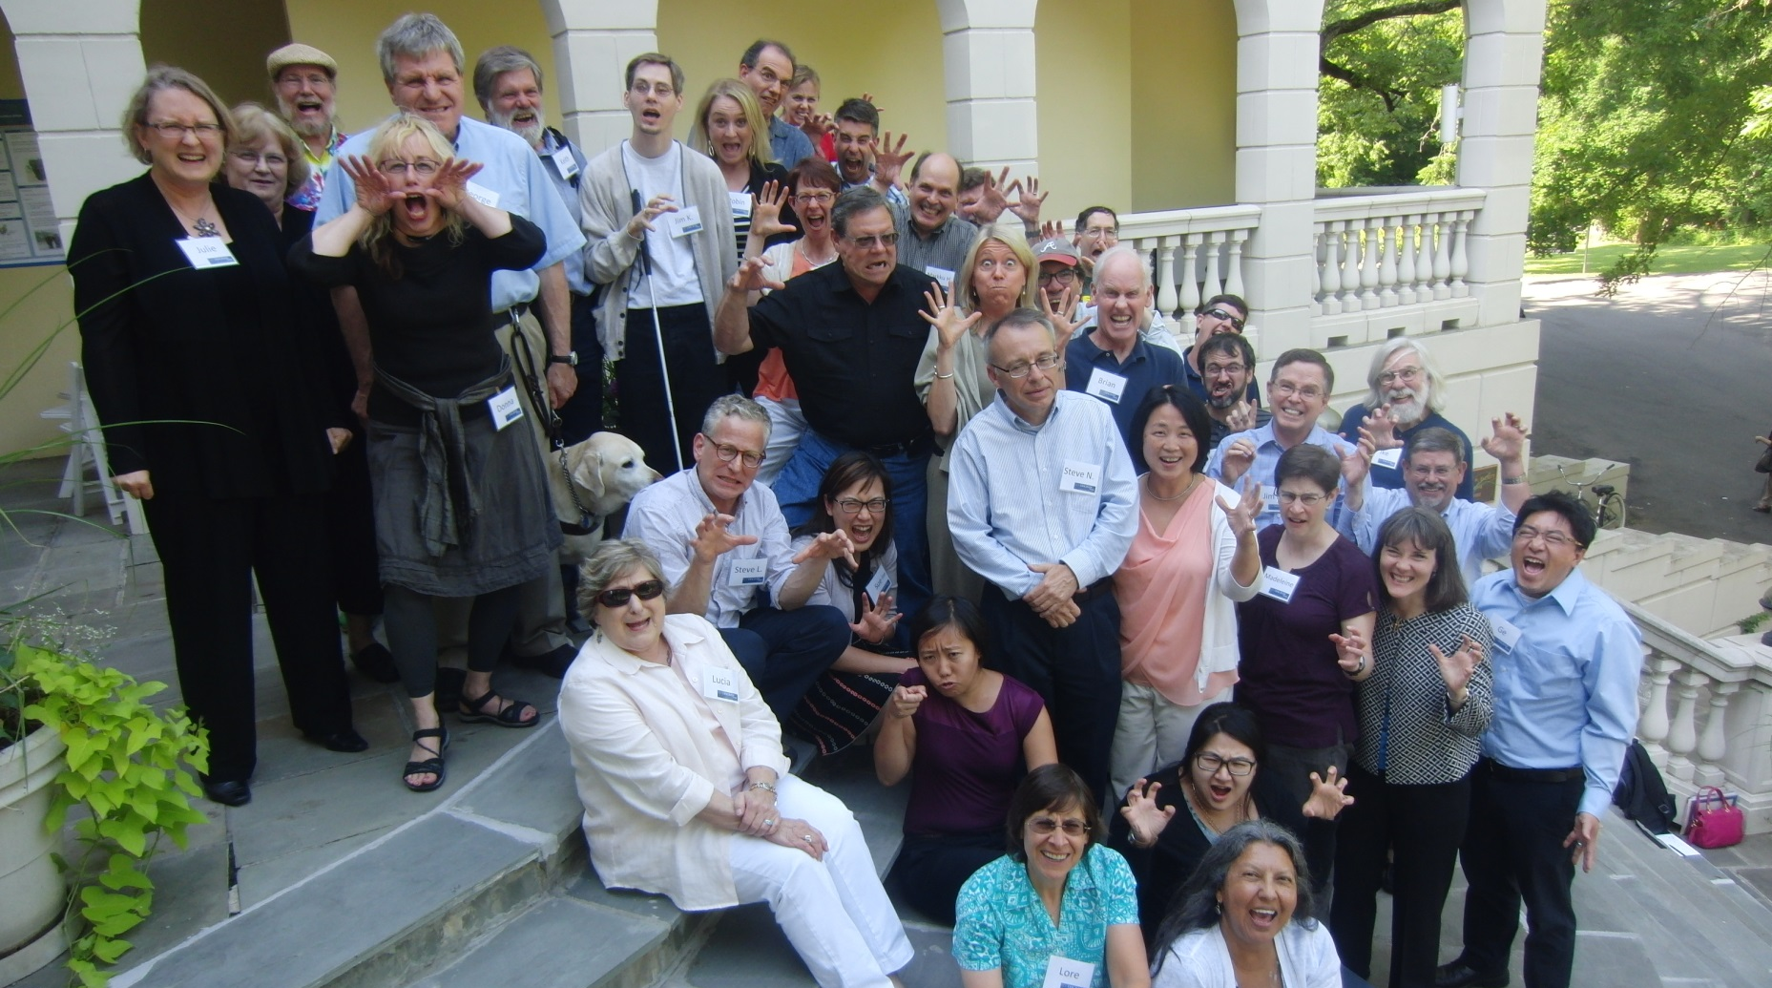
DIAGRAM Center Community
“Most wonderful collaboration I have ever been a part of.”
– DIAGRAM Community Member
Notes:
Image: Posed group photo of about 40 DIAGRAM community members standing on steps making "scary" faces.
We believe that our “Born Accessible” vision for images can best be achieved by creating communities of people who are working on solutions to accessible images and bringing them together so that we can share and align our work for the greatest benefit of our end users: students with print disabilities who need to understand the images in digital books and web sites.
We have a 27-member Advisory Board with Technologists, Educators, Publishers, Accessibility experts, Student/Parent reps, and students. Working Groups with dozens of volunteers across various working groups: Outreach, Tools, Developers, Standards, Content, Math, Tactile Graphics. Our working groups and advisory board members include representatives from Google, Adobe, Macmillan Learning, Learning Ally, the APH, NFB, National Braille Press, Humanware, American Thermoform, PhET, ETS, Smith-Kettlewell Eye Institute, and many more. We are a community of experts passionate about accessible educational content.

Slide 5
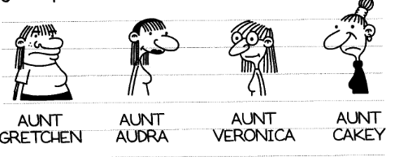
Example 1:
Which description is better?
Description A:
Greg’s four aunts are pictured in a row with their names under the portraits. Aunt Gretchen is plump, Aunt Audra is fashionable, Aunt Veronica is nerdy, and Aunt Cakey is mean.
Description B:
Greg’s four aunts are pictured in a row with their names under their portraits. Aunt Gretchen has shoulder-length hair and bangs, a t-shirt, a large, bulbous noise, and freckles. Aunt Audra also has shoulder-length hair, but it’s darker than Aunt Gretchen’s. She has an oval-shaped nose, she is smiling and wearing lipstick. Aunt Veronica has straight hair, bangs, glasses, and a pointier nose. Aunt Cakey has her hair in a bun on top of her head. She has an oval-shaped nose, she is frowning and wearing a black turtleneck.
Jeff Kinney (2013). Diary of a Wimpy Kid: Hard Luck (Diary of a Wimpy Kid #8). Abrams.
Notes:
Option B is the better because it provides objective descriptions and avoids interpretation (e.g., plump, fashionable, nerdy, mean)

Slide 6
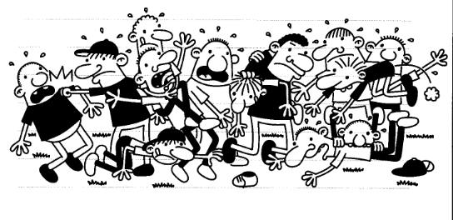
Example 2:
How can we improve the description?
Jeff Kinney (2013). Diary of a Wimpy Kid: Hard Luck (Diary of a Wimpy Kid #8). Abrams.
Description:
From left to right: a boy frowns with his mount open as a boy in a baseball cap punches him in the jaw. In front of the boy who is punching, another boy kneels down and reaches towards a shoe. Next to the boy punching the other boy, a boy stretches both arms out and has his mouth open. A boy behind him sticks his tongue out and strangles the boy in front of him. To the right of these two another boy has his mouth open and reaches down towards the shoe with one hand while grabbing another boy by the hair with the other hand. The boy whose hair is being grabbed is flung over another boy’s shoulder. To the right of these boys are two more boys reaching forward for the shoe from the back, one boy flying through the air toward the shoe, and another two boys on the ground, one of whom is biting the other boy’s back as he reaches for the shoe. 13 boys are fighting for a shoe on the ground in front of them.
Better Description:
13 boys wrestle and fight for a shoe that sits on the ground in front of them.
Notes:
Don’t attempt to describe everything – be succinct!

Slide 7
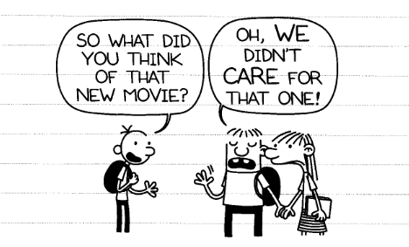
Example 3:
How can we improve the description?
Jeff Kinney (2013). Diary of a Wimpy Kid: Hard Luck (Diary of a Wimpy Kid #8). Abrams.
Description:
A boy has a black backpack on, and a shirt and pants. He has three hairs sticking up from his head. He has one hand up with three fingers on it outstretched. There is a speech bubble above his head and in it are the words “SO WHAT DID YOU THINK OF THAT MOVIE?” Another boy is holding hands with a girl. He has one hand up and it appears to be moving. He has big buck teeth, a shirt, pants, and a black carrying pack on too. There is a speech bubble above his head that says “OH, WE DIDN’T CARE FOR THAT ONE!” The girl has straight hair and she is wearing a t-shirt and a striped skirt and she is holding a book in her other hand. She appears to be frustrated and doesn’t have a book bag.
Better Description:
Greg looks at Rowley and Abigail, who are holding hands, and asks “So what did you think of the new movie?” Rowley waves one hand and has his eyes closed. He says, “Oh, we didn’t care for that one!”
Notes:
Use similar tone and language, but don’t replicate everything (e.g., is it necessarily to present the speech bubbles in all caps?)

Slide 8
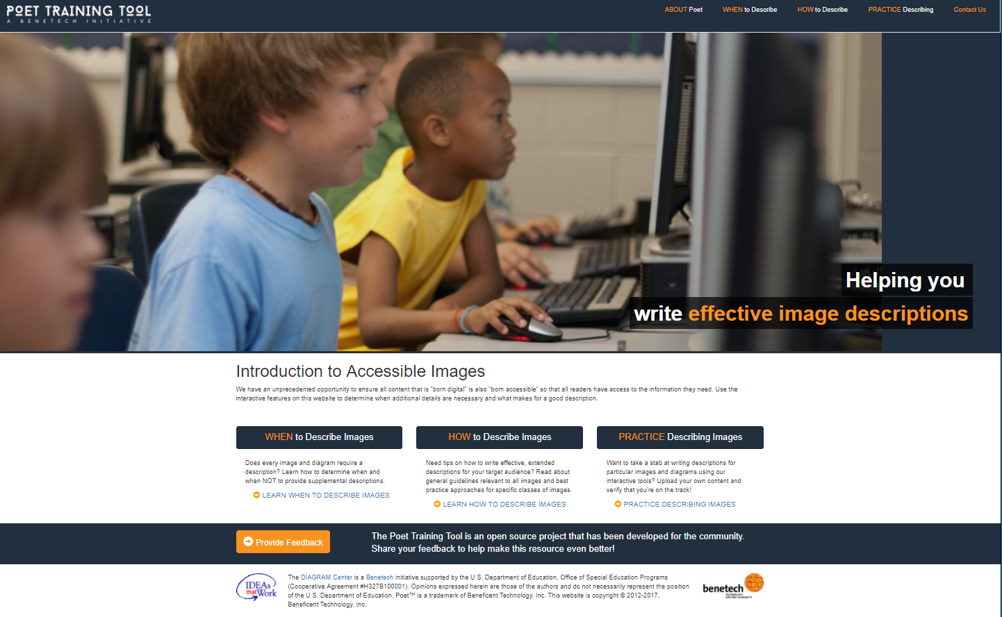
Poet Training Tool
Website: https://poet.diagramcenter.org/index.html
Notes:
Poet Training Tool is available at: https://poet.diagramcenter.org/index.html

Slide 9
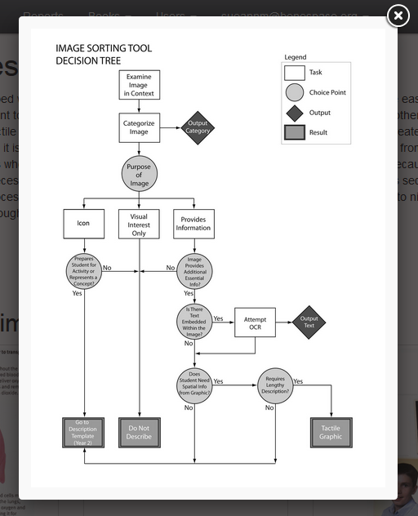
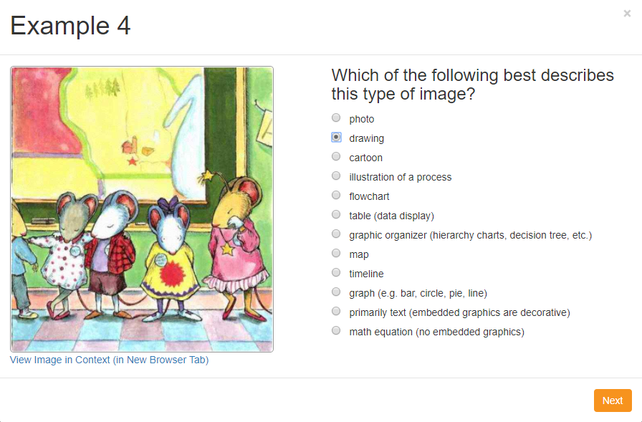
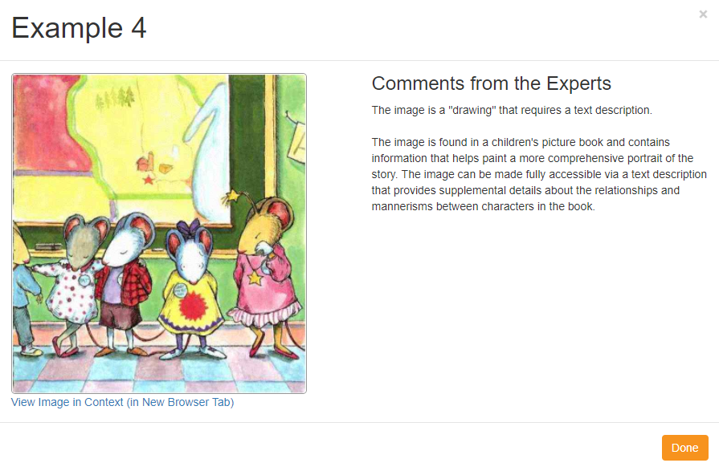
When to Describe?
Notes:
Decision Tree developed through DIAGRAM subcontract with Touch Graphics
Not all images should be described!
Users are guided through a series of questions to help them determine how best to treat an image.

Slide 10
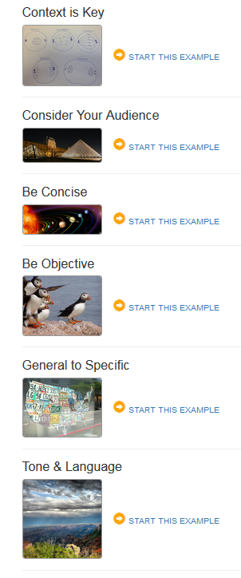
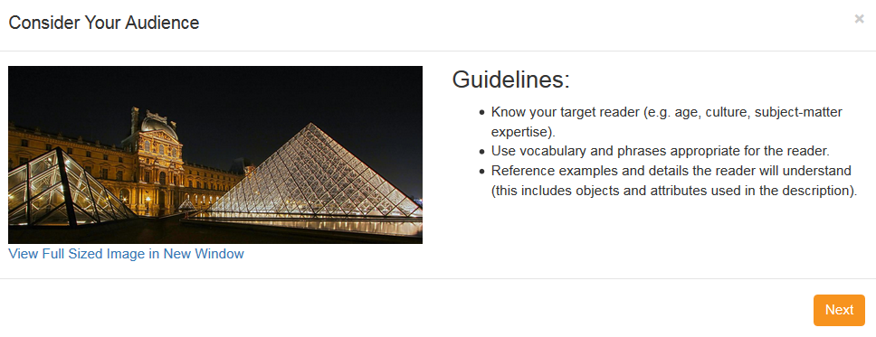
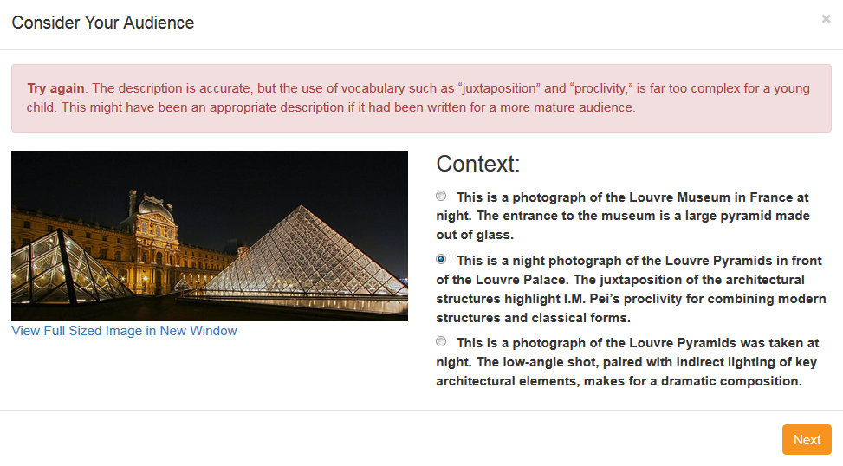
How to Describe? (general image guidelines)
Notes:
Once deemed that an image requires a text description, we address HOW to do this
First, the online tool provides general guidelines that applies to description writing for ALL images (e.g., audience, context, color, language, etc.)

Slide 11
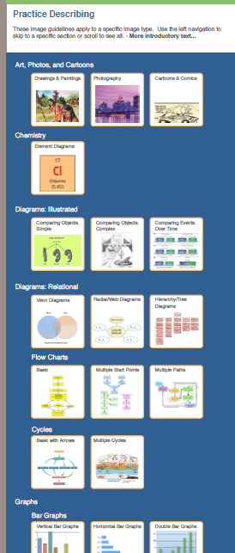
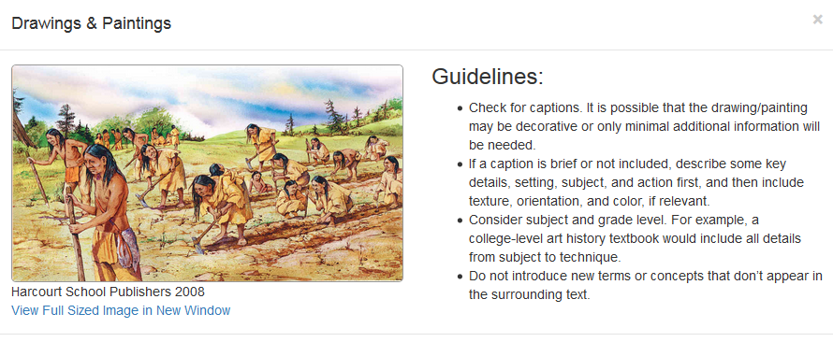
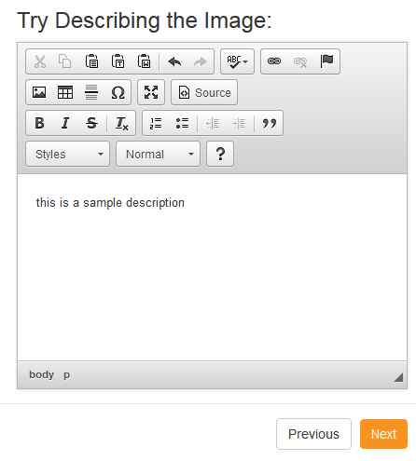
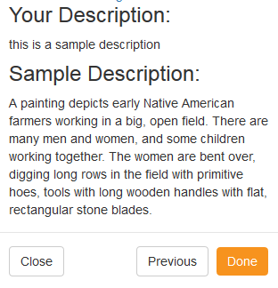
How to Describe? (specific image guidelines)
Notes:
Then, guidelines and examples that apply to SPECIFIC TYPES of images (e.g., cartoons, scatter plot, pie chart, maps, etc.)
First set was developed first developed by NCAM (National Center for Accessible Media), but DIAGRAM collaborated to expand the set and make it more friendly per feedback from various volunteer “describe-a-thons”

Slide 12
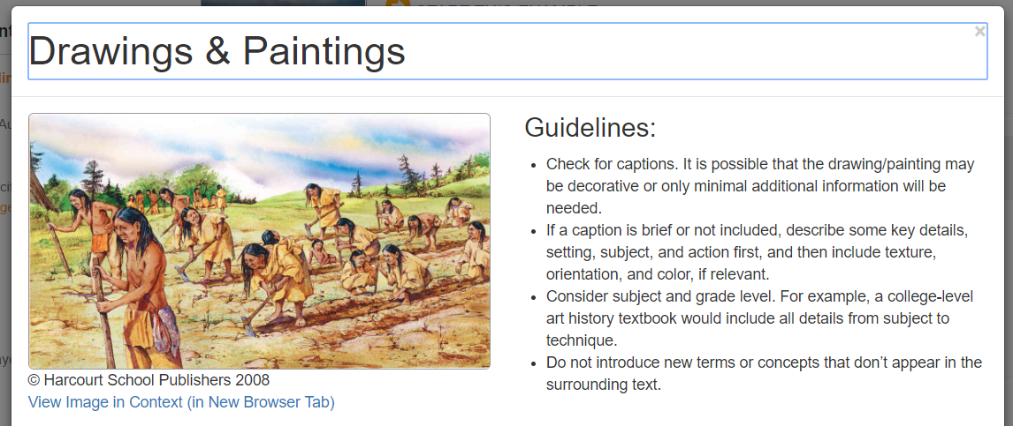
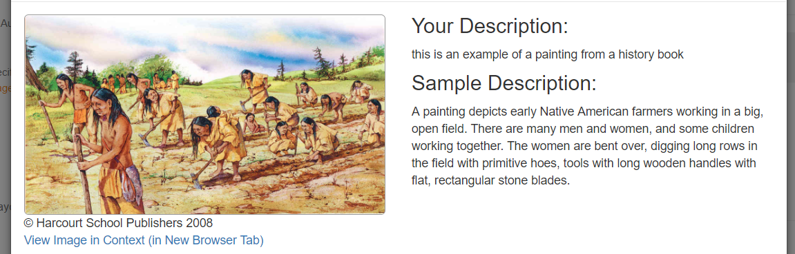
How to Describe: Drawings & Paintings

Slide 13
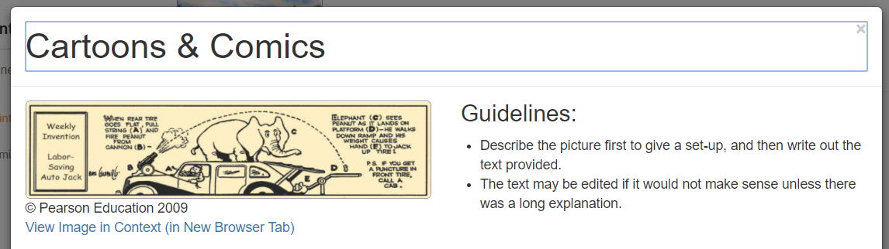
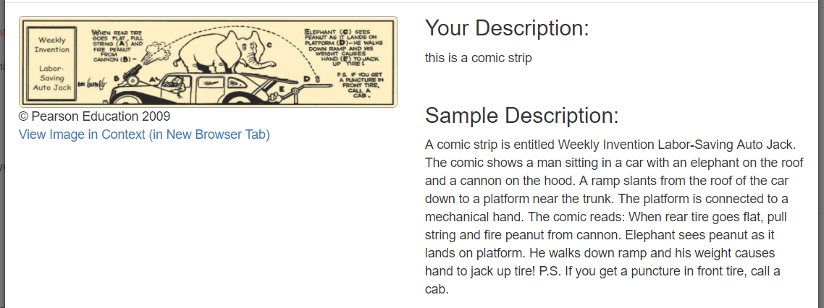
How to Describe: Cartoons & Comics

Slide 14
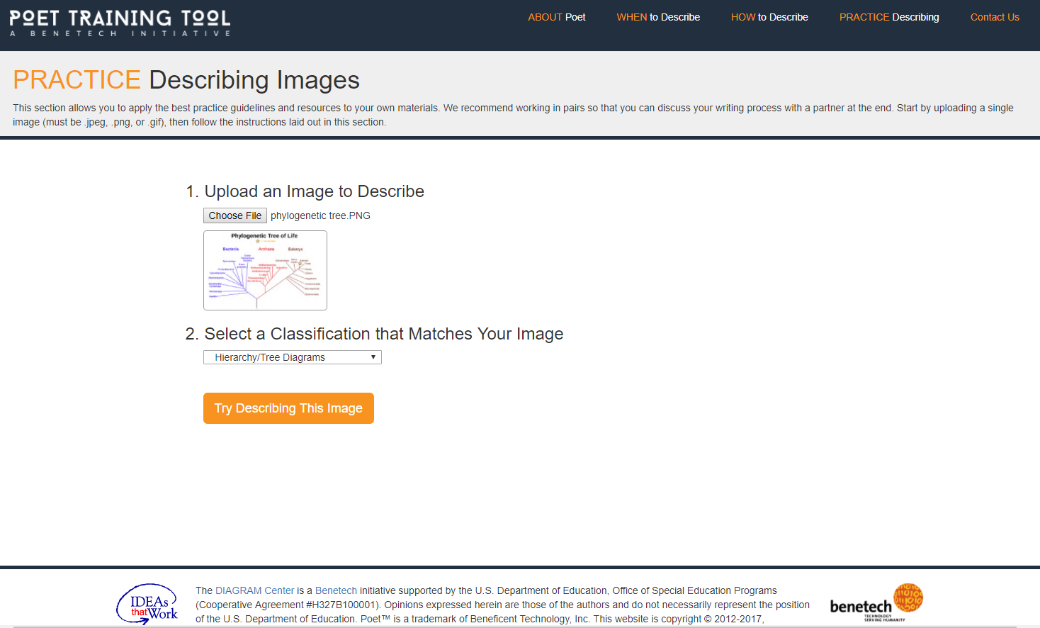
Practice Describing
Notes:
Lastly, provide users with an opportunity to use the same templates and approach to practice on their own materials
Pearson Publishing: hugely important to encourage collaborative practice and discuss the various approaches applied by different individuals

Slide 15
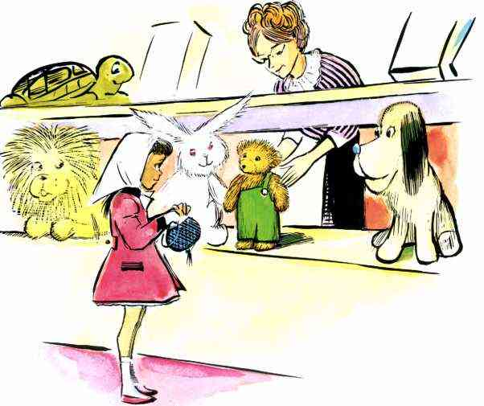
Example 1:
Descriptions for Young Readers
Corduroy was just waking up when the first customers came into the store in the morning. And there, looking at him with a wide, warm smile, was the same little girl he'd seen only the day before.
Description: Lisa stands in front of a case filled with toys. She is holding up a round, blue purse. A woman reaches into the case towards Corduroy, who stands in the case, facing Lisa.
Explanation: Since we’ve met Lisa already, we can refer to her by name. We’ve seen other images of her, so there’s no need to describe her outfit more than the initial time. Since we haven’t seen her purse before, that should be described. While we could go into detail about the other toys in the case, we aren’t because they aren’t important to the story. Also, describing them would make this explanation rather wordy, which we’re trying to avoid.
Don Freeman (1968). Corduroy. Puffin Books.
"I'm Lisa," she said, "and you're going to be my very own bear. Last night I counted what I've saved in my piggy bank and my mother said I could bring you home."

Slide 16
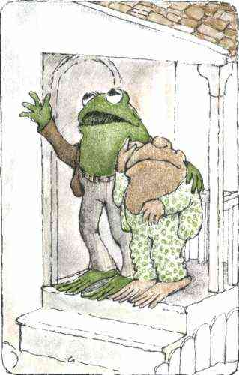
Example 2:
Descriptions for Young Readers
"Don't be silly," said Frog. "What you see is the clear warm light of April. And it means that we can begin a whole new year together, Toad. Think of it," said Frog.
"We will skip through the meadows and run through the woods and swim in the river.
In the evenings we will sit right here on this front porch and count the stars.“
Description: Frog and Toad are standing on the porch. Frog looks upwards and gestures up with one hand. His other hand rests on Toad’s shoulders. Toad has one hand on his head and has both eyes closed. He’s wearing green-and-white spotted pajamas.
Explanation: The text tells us that Frog and Toad are chatting and that Toad is tired. It doesn’t go into detail about the porch or what Frog is wearing. Describing Toad’s pajamas reinforces the fact that he’s tired and gives the reader something to visualize.
Arnold Lobel (1970). Frog and Toad Are Friends. HarperCollins Publishers.
"You can count them, Frog," said Toad. "I will be too tired. I am going back to bed."

Slide 17
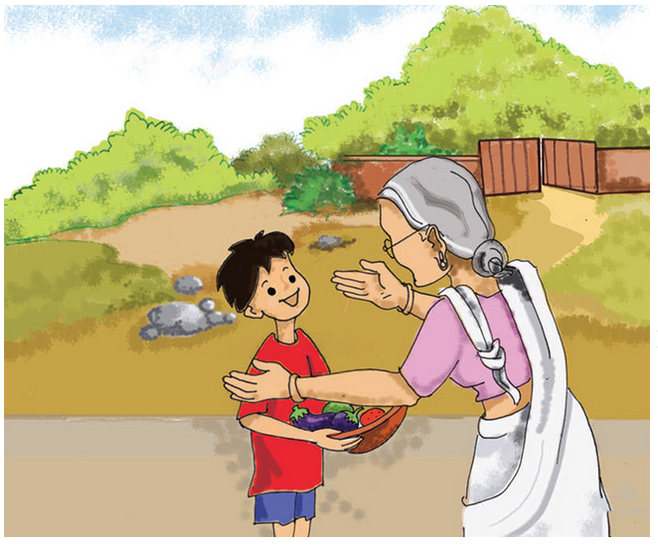
Try Describing – Example 1:
Dadi says, “Well done, Maaloo! Go and get some potatoes.
Sample description:
Maaloo shows his grandmother, Dadi, the basket of vegetables that he has piced. Dadi approaches Maaloo with open arms.
Vinita Krishna (2006). Aaloo, Maaloo, Kaaloo. Pratham Books.

Slide 18
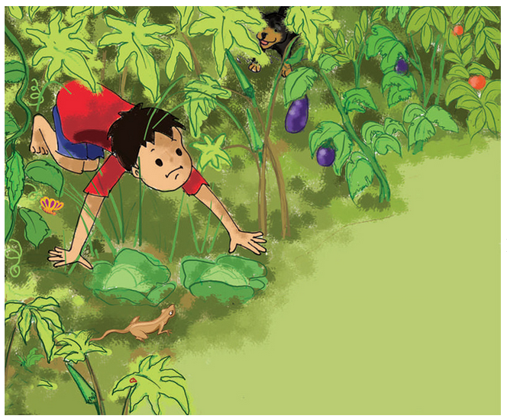
Try Describing – Example 2:
Maaloo looked at the trees, creepers and plants. Not a single potato could he see.
Sample description:
Maaloo and his dog, Kaaloo, crawl around the vegetable garden searching for potatoes.
Vinita Krishna (2006). Aaloo, Maaloo, Kaaloo. Pratham Books.

Slide 19
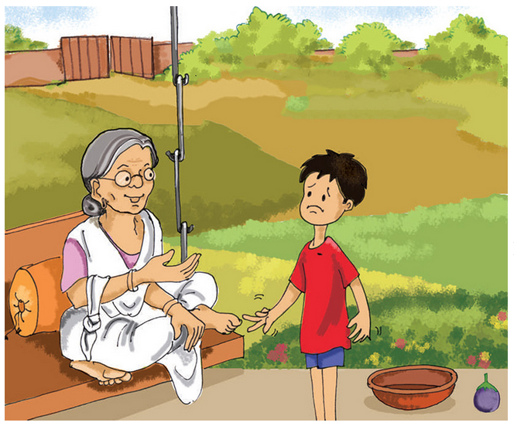
Try Describing – Example 3:
“Dadi, the potatoes aren’t ready yet,” said Maaloo, putting the empty basket down.
“No Maaloo, there are plenty of potatoes. Look carefully,” said Dadi.
Sample description:
A smiling Dadi is seated comfortably outdoors on a swing bench as she talks to a frowning Maaloo. There is an empty basket on the ground next to Maaloo.
Vinita Krishna (2006). Aaloo, Maaloo, Kaaloo. Pratham Books.

Slide 20
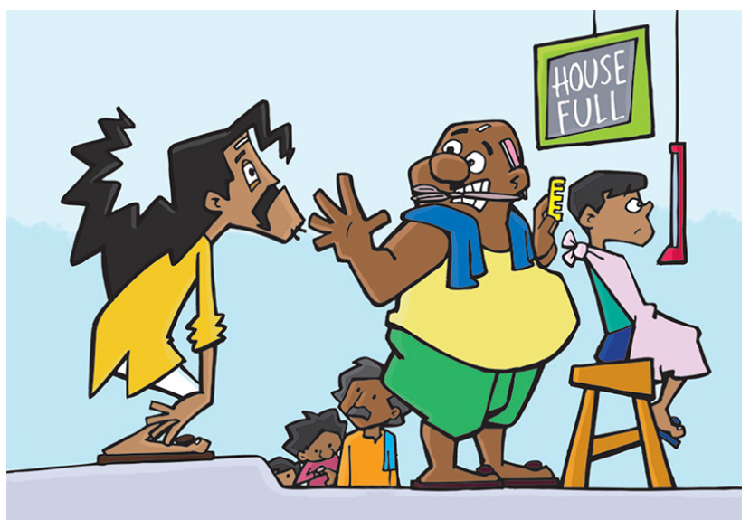
Try Describing – Example 4:
But the barber said, “Today, I have no time to cut such long hair!”
Sample description:
The barber holds his hand up to a frowning Srigeri Srinivas who is a slouched over. The barber is serving another customer and there are three additional customers in the queue. “House FulI” is written on a board.
Noni (2007). Annual Haircut Day. Pratham Books.

Slide 21
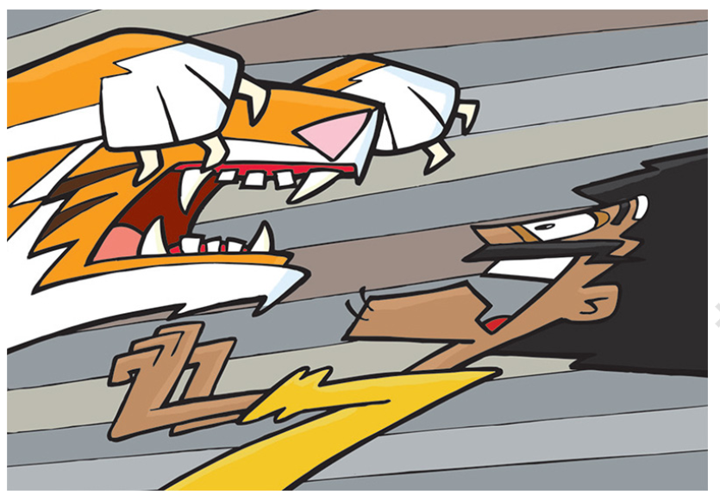
Try Describing – Example 5:
Poor Sringeri Srinivas was so scared, so scared, so scared that…
Sample description:
A roaring tiger, bearing teeth and claws, lunges towards Srigeri Srinivas. Srigeri Srinivas’s eyes and mouth are wide open as he backs away from the tiger.
Noni (2007). Annual Haircut Day. Pratham Books.

Slide 22

Try Describing – Example 6:
…all the hair fell off his head!
Sample description:
A view of Srigeri Srinivas through the tiger’s open month. Srigeri Srinivas’s hands are raised up next to his face while his hair and mustache detach from his head.
Noni (2007). Annual Haircut Day. Pratham Books.

Slide 23
Questions?

Slide 24
Resources
Poet Training Tool: https://poet.diagramcenter.org/
DIAGRAM Webinars (& related guidelines)
  Accessible Image Sample Book: http://diagramcenter.org/diagramwebinars.html#aisb
  Complex Images: http://diagramcenter.org/diagramwebinars.html#compleximages, http://diagramcenter.org/diagramwebinars.html#a11yimages

Slide 25
Thank You!
Sue-Ann Ma (sueannm@benetech.org)

