Slide 1
Book Boost: Access for All Challenge, Guidelines for Creating Accessible Ebooks (part 1): EPUB Accessibility
Charles LaPierre, Technical Lead, DIAGRAM and Born Accessible

Slide 2



Benetech’s Global Literacy Program
Born Accessible: Creating accessible books from the start
Born Accessible is a partnership with publishers and content creators to help them build accessibility into books when they are first created.
DIAGRAM Center: Building new paths to accessibility
DIAGRAM is a research and development center that creates tools, standards and best practices to support different learning needs.
Bookshare: Making reading accessible
Bookshare is the world’s largest library of accessible ebooks and lets people with visual, physical, and learning disabilities like dyslexia read in ways that work for them.
Notes:
Benetech has three initiatives to help promote, educate and share accessible materials. Our Born Accessible Initiative works directly with publishers to help then create accessible eBooks so that when a book born digital is also born accessible. The Diagram Center works with standards bodies and the community to create standards, guidelines and best practices to ensure digital content including eBooks are fully accessible. Bookshare then provides access to these materials in an accessible format.
Making eBooks accessible isn’t rocket science, but there is a lot of stuff, so we're here to help. There are well defined standards, guidelines, best practices, and examples to help you along. You are not alone, and making your books accessible not only helps the disabled but anyone who wants the book to just self read when their eyes are tired after a long day, or just wants to increase the font to see what that footnote says and being able to zoom in yourself just makes for a better overall end user experience.

Slide 3

About myself
Working in the accessibility field for over 20 years
co-editor of the EPUB Accessibility 1.0 Specification
contributor to the BISG’s Quick Start Guide for Accessible Publishing
co-facilitator of the Digital Publishing Accessibility Task Force within the W3C

Slide 4
Agenda
Standards
  World Wide Web Consortium (W3C) Accessibility Guidelines;
  Semantic Markup (epub:type / ARIA / HTML)
  EPUB Accessibility 1.0 Specification / Metadata (Discovery)
Guidelines / Help
  Book Industry Study Group (BISG) Quick Start Guide to Accessible Publishing / Top Tips
  Code Samples
  Useful Links (Appendix)
Tools
  epubCheck & Accessibility Checker for EPUBs (ACE by DAISY)
Benetech’s EPUB GCA Initiative
Questions

Slide 5
Standards

Slide 6


Standards at the Core of Accessibility
World Wide Web Consortium (W3C)
  HTML5, CSS, SVG, MathML
Web Accessibility Initiative (WAI)
  Web Content Accessibility Guidelines (WCAG 2.0)
    W3C Recommended December 2008
  Accessible Rich Internet Applications (ARIA 1.0)
    W3C Recommended March 2014
International Digital Publishing Forum (IDPF)
  EPUB the digital publishing standard built on Web technologies (i.e., HTML5, CSS, ARIA, etc.)

Slide 7

EPUB within the World Wide Web Consortium (W3C)
IDPF earlier this year merged into the W3C which places EPUB within the W3C’s domain.
EPUB is fundamentally web pages bundled together in this “EPUB” container, and any accessibility improvements for the web will ultimately end up in EPUB.
EPUB 3.1 is an approved recommendation (January 5, 2017)
Included is EPUB Accessibility 1.0
Conformance and Discovery Requirements for EPUB Publications
We want to be practical in that publishers should readily be able to produce accessible EPUB from their normal production process
Important: First ever specification to enable
accessibility certification!

Slide 8
Intro to WCAG
Web Content Accessibility Guidelines (WCAG) 2.0 covers a wide range of recommendations for making Web content more accessible.
Following these guidelines will make content accessible to a wider range of people with disabilities, including blindness and low vision, deafness and hearing loss, learning disabilities, cognitive limitations, limited movement, speech disabilities, photosensitivity and combinations of these.

Slide 9

Four Principals of WCAG
Perceivable - Information and user interface components must be presentable to users in ways they can perceive (e.g. See and Hear content).
Operable - User interface components and navigation must be operable (e.g. Typing, Mouse or by Voice)
Understandable - Information and the operation of user interface must be understandable.
Robust - Content must be robust enough that it can be interpreted reliably by a wide variety of assistive technologies (e.g. Screen Readers and Magnifiers)

Slide 10
WCAG 2.0
LEVEL - A

Slide 11
WCAG 2.0 –A : Perceivable
1.1.1 Non-text Content
  Image Descriptions
1.3.1 Info and Relationships
  Headings, Lists, Tables, Asides, Footnotes
1.3.2 Meaningful Sequence
  Spine: All content documents are listed in the correct reading order.
1.3.3 Sensory Characteristics
  Identification of an object by its color, shape, size, position alone.
1.4.1 Use of Color
  No dependencies on perception of color

Slide 12
WCAG 2.0 –A : Operable
2.1.1 Keyboard
2.1.2 No Keyboard Trap
2.4.2 Page Titled
2.4.3 Focus Order
2.4.4 Link Purpose (In Context)

Slide 13
WCAG 2.0 –A : Understandable
3.1.1 Language of Page
3.2.1 On Focus
3.3.2 Labels or Instructions
4.1.1 Parsing
  Passes EPUBCheck without error

Slide 14
WCAG 2.0 –A : Robust
4.1.2 Name, Role, Value
  Check that all controls have a name and role, and all states and properties necessary to for user interaction are set and function properly.

Slide 15
WCAG 2.0
LEVEL - AA

Slide 16
WCAG 2.0 –AA : Perceivable
1.4.3 Contrast (Minimum)
1.4.4 Resize text
1.4.5 Images of Text

Slide 17
WCAG 2.0 –AA : Operable
2.4.5 Multiple Ways
2.4.6 Headings and Labels
2.4.7 Focus Visible

Slide 18
WCAG 2.0 –AA : Understandable
3.1.2 Language of Parts
3.2.3 Consistent Navigation
3.2.4 Consistent Identification

Slide 19
Semantic Markup & ARIA
Make sure everything is semantically marked up using HTML, ARIA roles and EPUB specific types.
Document Portions | Epub:type values | ARIA Roles
Cover | cover | doc-cover
Chapter | chapter | doc-chapter
Title Page | titlepage
Table of Contents | toc | doc-toc
List of Images | loi
Page Breaks | pagebreak | doc-pagebreak
End Notes | rearnotes | doc-endnote
Page List | page-list

Slide 20
Accessibility 1.0 Specification
Requires accessibility conformance in the EPUB publication
Builds on WCAG 2.0 with some additional publishing-specific items
the accessibility spec applies to all versions of EPUB not just EPUB 3.1

Slide 21
Concrete Examples of Some MUSTS
All headings must be marked in the HTML as headings (critical for navigation).
All textual content must use HTML text markup, e.g., paragraphs, block quotes, and list items.
All content must be in a logical reading order.
Images must be marked as presentation, described in surrounding text, have captions, or have “alt” text.
A conformant EPUB Publication must meet the following criteria when it includes page navigation and there a print equivalent book:
  must provide a means of locating the page break locations
  must identify the source of the page breaks

Slide 22
Discoverability:
Metadata Requirements to Be Compliant
Accessibility Metadata
  Must include the following [schema.org] metadata:
    accessMode
    accessibilityFeature
    accessibilityHazard
    accessibilitySummary
  Recommended metadata:
    accessModeSufficient

Slide 23
Guidelines

Slide 24

BISG Quick Start Guide--Top Tips (1 of 2)
Use HTML5
Use HTML5 headings (H1 – H6)
Use HTML5 tags and EPUB 3 structural semantics
Provide complete navigation
Provide content in a logical reading order
Separate presentation from content
Do not use images to represent tables
Use correct markup for decorative images
Use image descriptions for complex, content-rich images

Slide 25
BISG Quick Start Guide--Top Tips (2 of 2)
Use page numbers when there is a print equivalent
Define the language(s)
Consider using the EPUB 3 “EPUB for Education” profile
Use MathML
Provide alternative access to media content
Make interactive content accessible
Use accessibility metadata
NOTE: The “Top Tips” will need to be updated now that the Accessibility 1.0 Specification has been recommended. This work is just now being launched in the BISG’s Accessible Publishing Working Group.

Slide 26
Important Things to Note (1 of 3)
Make sure all images have a short alt text try to keep under 200 characters if possible.
Decorative Images must have alt=“” and we recommend also including role=“presentation”
The hierarchy of <h1>–<h6> is often misapplied or doesn’t cascade properly. Skipped heading levels and missing top-level headers are a common mistake.
Many EPUBs have the <title> of the HTML file wrong, containing the title of the ebook but not that chunk of HTML.

Slide 27
Important Things to Note (2 of 3)
There are occasionally validation errors in EPUBs such as metadata that doesn’t meet EPUB 3 standards.
Language shifts are frequently not marked or marked with incorrect language codes as such within the context of the HTML.
Links that have no visual cue and are highlighted with the same color as the text cannot be recognized.
Tabular content is frequently missing a correctly marked-up header row, which is crucial for providing context while a screen reader user is exploring a complex table.

Slide 28
Important Things to Note (3 of 3)
There are frequently problems with color contrast from too-light display colors in headers or other holdovers from print.
Emphases/Strong and Bold/Italic are often confused with each other and thus used incorrectly.
Missing <aside> tags, marking content as secondary, is a frequent misstep.
Make sure you have defined landmarks within your EPUB

Slide 29
Landmarks
cover
titlepage
frontmatter
bodymatter
backmatter
Table of Contents (toc)
acknowledgements

Slide 30
Adding Semantics: Example Code
<section epub:type=“chapter” role=“doc-chapter”>
<span epub:type=“pagebreak” id=“page2” title=“2” />
<h1>Chapter 1: Introduction</h1>
<p> … </p>
<span epub:type=“pagebreak” id=“page3” title=“3” />
<p> … </p>
…
</section>

Slide 31
Page List Navigation: Example Code
<nav epub:type=“page-list”>
<ol>
<li><a href=“Introduction.xhtml#page2”>2</li>
<li><a href=“Introduction.xhtml#page3”>3</li>
<li><a href=“Characters.xhtml#page4”>4</li>
…
</ol>
</nav>

Slide 32
Table Markup
Tables is one area which has some accessibility concerns
<table summary=“Here we have our lunch menu which showcases a Salads, Entrées and Desserts.”>
<caption>Today's Lunch Menu</caption>
<tr>
<th>Salad</th>
<th>Entree</th>
<th>Dessert</th>
</tr>
<tr>
<td>Caesar</td>
<td>Chicken Divan</td>
<td>Chocolate Mousse</td>
</tr>
… </table>

Slide 33
Tools

Slide 34
epubCheck
This tool checks to ensure your EPUB is conformant to the EPUB specification.
Command Line tool with the output looking like:
java -jar epubcheck.jar QuickStartA11y_Jan.epub
Validating using EPUB version 3.0.1 rules.
No errors or warnings detected.
epubcheck completed

Slide 35

ACE by DAISY (Accessible Checker of EPUB)
DAISY received a Google Impact Challenge Award under which it will create a tool to check EPUBs against the EPUB Accessibility 1.0 Specification.
  Will be open source
  Is built on existing HTML checking technology (aXe by Deque) with additional EPUB-specific tests
  Will have both a command line and APIs interface to run the tool
  Will generate both human and machine readable reports
  Performs many tests that can be automated
  Identify areas that need manual inspection
  Scheduled to be released Jan 2018

Slide 36
DAISY’s ACE Will Not . . .
Automatically check all accessibility requirements
Certify an EPUB as being conformant
Check for valid EPUB format (recommend using epubcheck)

Slide 37
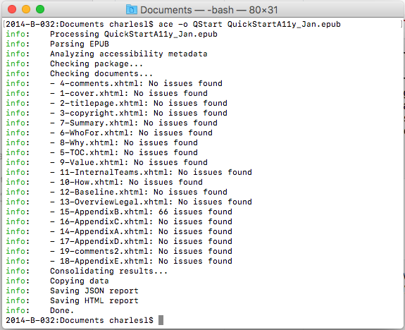
ACE: Command Line Tool

Slide 38
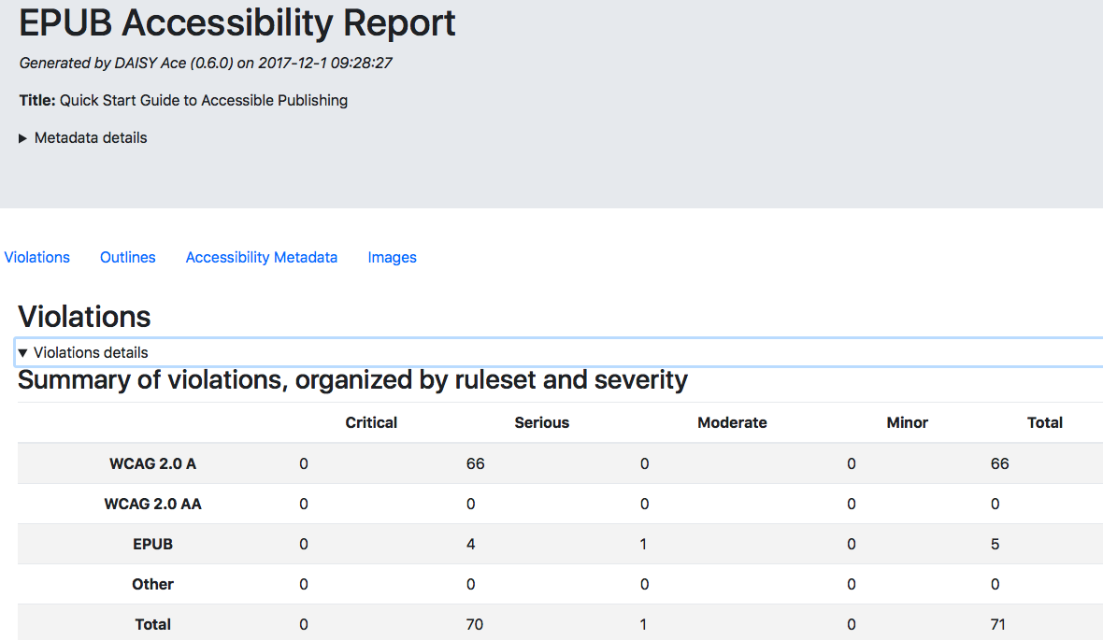
ACE: HTML Report

Slide 39
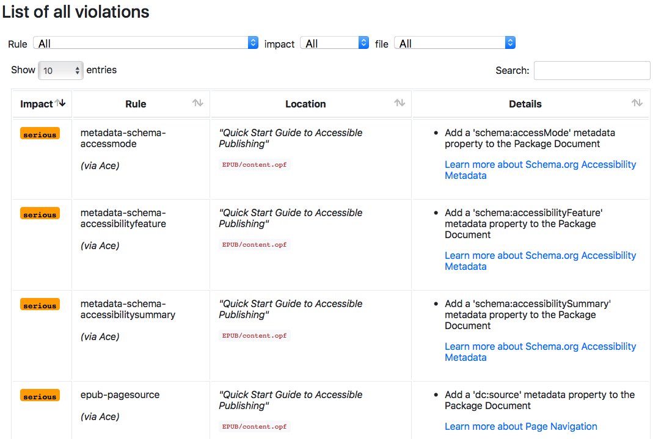
ACE Report – Violation Details

Slide 40
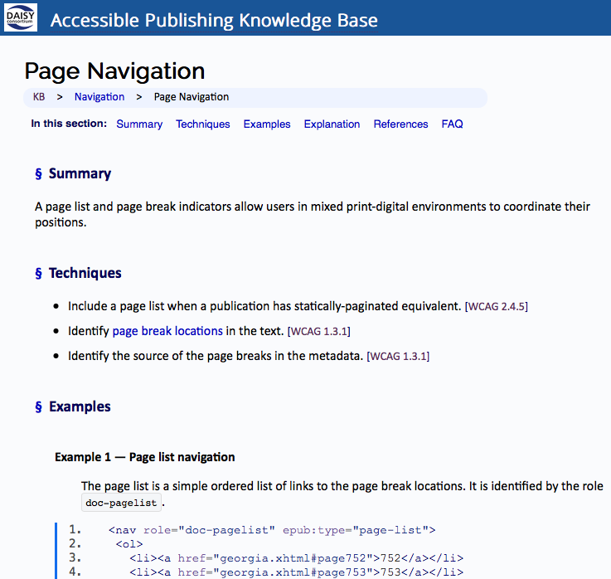
DAISY Knowledge Base

Slide 41
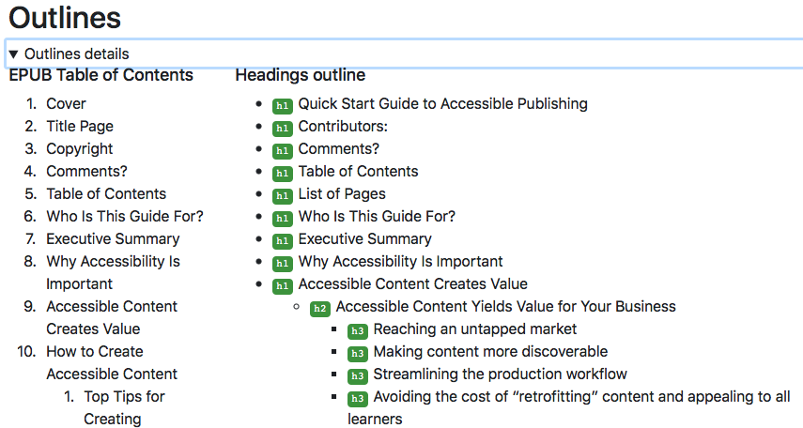
ACE: Command Line Tool – Structural Outline

Slide 42
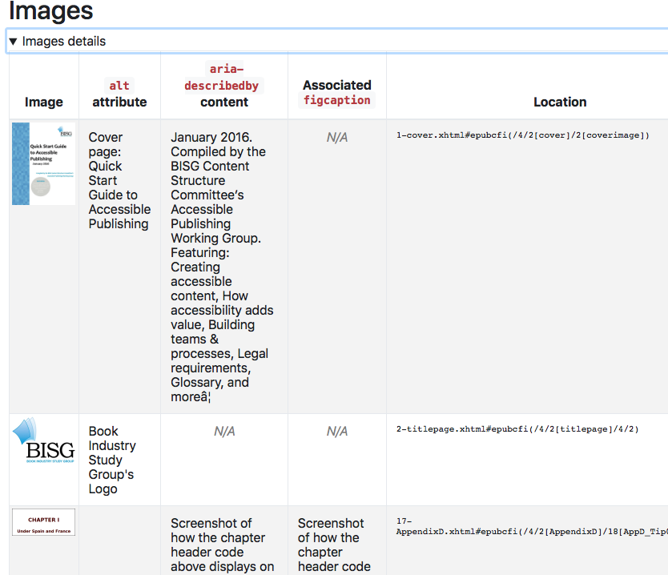
ACE HTML Report - Images

Slide 43

Global Certified Accessible (GCA)
Benetech establishes GCA program for third party auditing of EPUB to ensure conformance to the 1.0 Accessibility specification
Launched June, 2017
With Help from DAISY to shape the certification process
Partners: DAISY, Dedicon, RNIB, and Vision Australia

Slide 44
GCA Process
Use DAISY’s ACE tool to uncover some Accessibility issues
Manually open up each EPUB looking at a dozen specific areas then digging into each of those areas and providing a Born Accessible score on how each of those sections did.
Check for all WCAG A and AA violations to determine the overall WCAG conformance level obtained.
Check for all EPUB Accessibility 1.0 - Conformance and Discovery Requirements
Create a detailed report for publishers with their conformance level met and their overall Born Accessible Score.
Remediation steps recommended

Slide 45
GCA Conformance Review
For each title we performed a manual in-depth review:
  WCAG Compliance (A and AA)
  Image Accessibility
  HTML Tags
  General A11Y
  Language
  Structure Nav.
  Links
  Lists
  Tables
  Notes
  Metadata (required and optional)
  EPUB specific accessibility 1.0 requirements

Slide 46
Questions
Charles LaPierre, Technical Lead DIAGRAM and Born Accessible
Email: charlesl@benetech.org
?

Slide 47
Appendix: Helpful Links (1 of 3)
WCAG 2.0 Guidelines (AA RECOMMENDED)
  https://www.w3.org/TR/WCAG20/
Techniques for WCAG 2.0
  https://www.w3.org/TR/WCAG20-TECHS/
Accessible Rich Internet Applications (WAI-ARIA) 1.0
  https://www.w3.org/TR/2014/REC-wai-aria-20140320/
Digital Publishing WAI-ARIA Module 1.0
  https://www.w3.org/TR/dpub-aria-1.0/

Slide 48
Appendix: Helpful Links (2 of 3)
EPUB 3 Accessibility Guidelines (no longer maintained but still has useful information)
  https://idpf.github.io/a11y-guidelines/content/qa/qa-checklist.html
EPUB Accessibility 1.0 – Conformance and Discovery
  https://www.w3.org/Submission/epub-a11y/
EPUB Accessibility Techniques 1.0
  http://www.idpf.org/epub/a11y/techniques/techniques.html
Metadata: WebSchemas / Accessibility
  https://www.w3.org/wiki/WebSchemas/Accessibility
EPUB 3 Structural Semantics Vocabulary
  https://idpf.github.io/epub-vocabs/structure/

Slide 49
Appendix: Helpful Links (3 of 3)
EPUBCheck Validation Conformance Tool
  https://github.com/IDPF/epubcheck/releases
DAISY’s Accessible Checker for EPUB (ACE)
  https://github.com/daisy/ace/releases
DAISY’s Accessible Publishing Knowledge Base
  http://kb.daisy.org/publishing/
BISG’s Quick Start Guide to Accessible Publishing
  https://bisg.site-ym.com/store/ViewProduct.aspx?id=6972996
DIAGRAM Center’s “Top Tips for Creating Accessible EPUB 3 Files”
  http://diagramcenter.org/54-9-tips-for-creating-accessible-epub-3-files.html
DIAGRAM Center’s “Accessible Image Sample Book”
  http://diagramcenter.org/standards-and-practices/accessible-image-sample-book.html

